Slide 1
Hands-on Coding Session II Music Visualization
Dr. Srisupang Thewsuwan

Slide 2
Introduction

Slide 3

Music Visualization
The process of creating visual representations of audio signals, such as music.
To provide a way to analyze and understand audio signals, and to create visually appealing representations of audio signals for artistic or entertainment purposes.

Slide 4
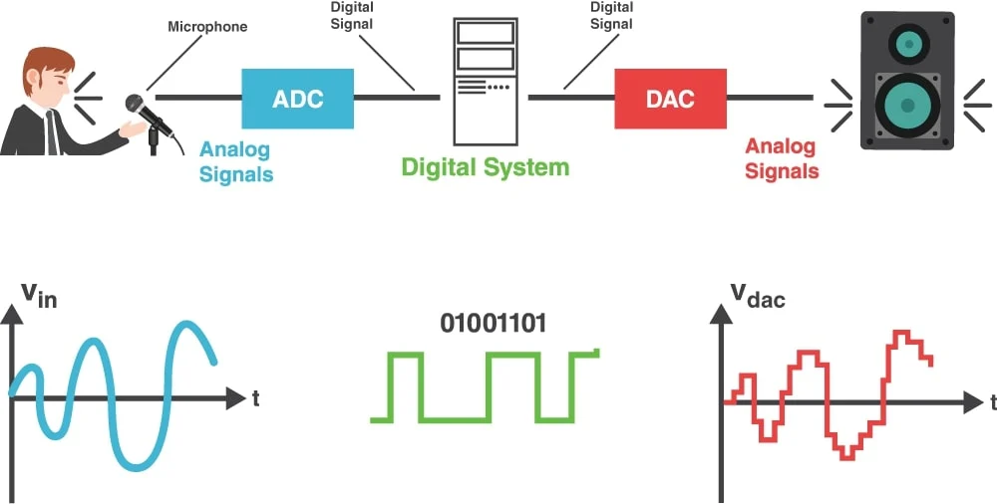
Audio signal processing

Slide 5
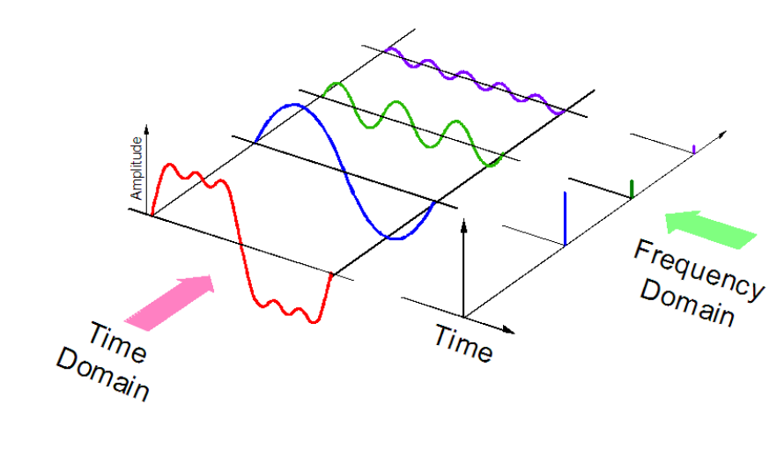
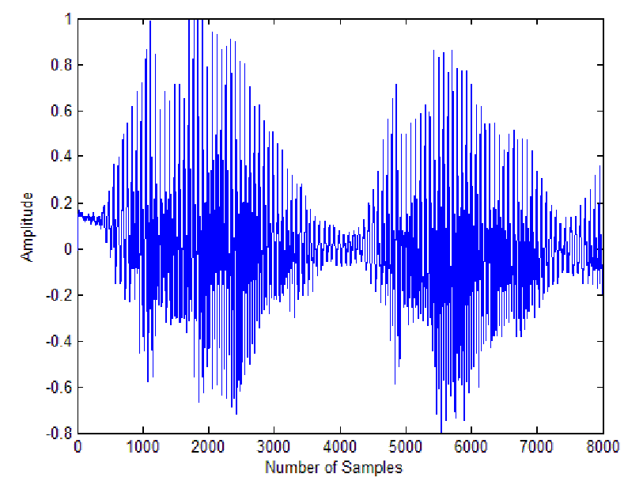
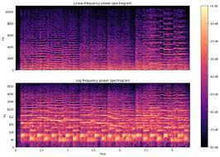
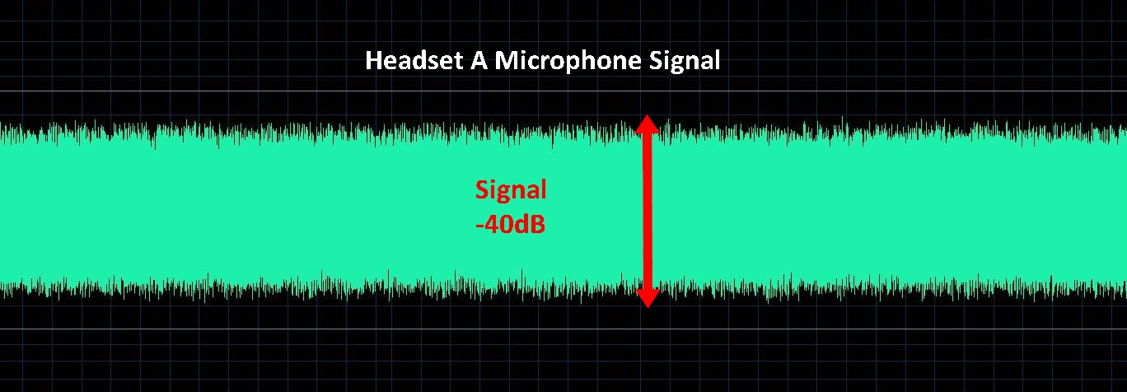
Audio input
Signal Processing
Data Representation
Visualization
Workflow
Beat detection

Slide 6
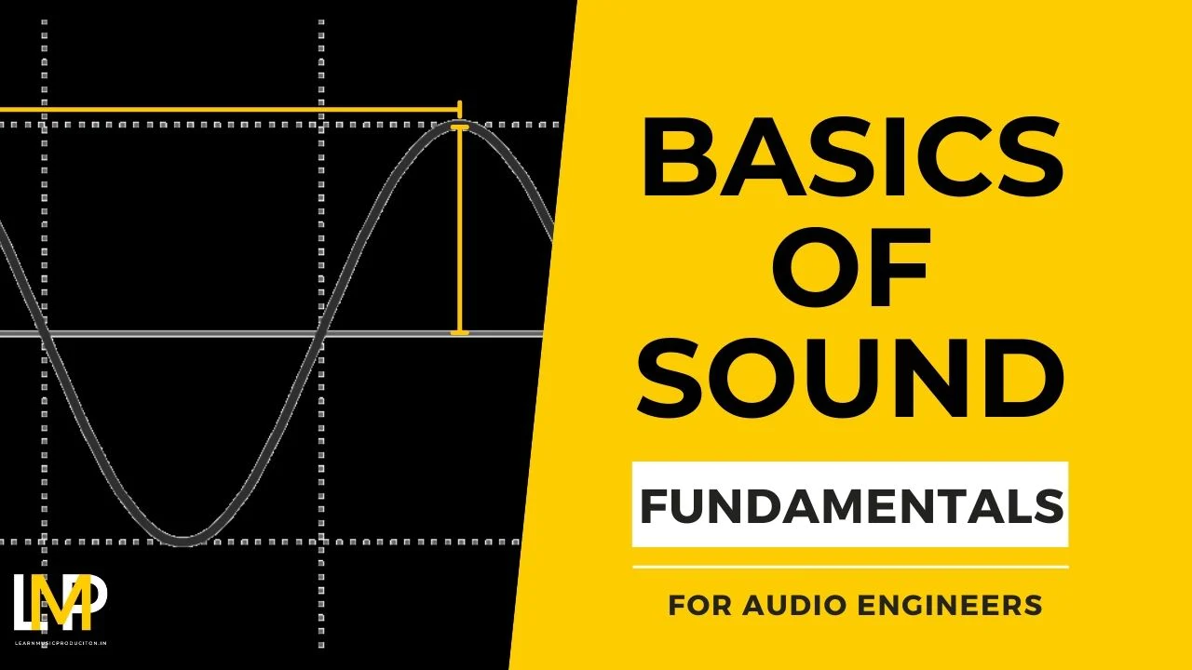
Significance in Audio Engineering
Importance of visualizing audio signals to understand frequency content, structure, and changes over time.
Applications in music production, sound design, and research.

Slide 7
01- Create Music control buttons

Slide 8
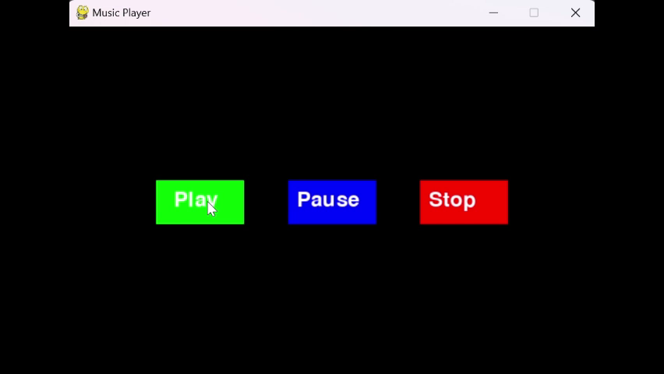
Task01-starter_music_playback
def draw_buttons():
# Draw the play button
pygame.draw.rect(screen, GREEN, play_button)
play_text = font.render('Play', True, WHITE)
screen.blit(play_text, (play_button.x + 20, play_button.y + 10))
# Draw the pause button
pygame.draw.rect(screen, BLUE, pause_button)
pause_text = font.render('Pause', True, WHITE)
screen.blit(pause_text, (pause_button.x + 10, pause_button.y + 10))
# Draw the stop button
pygame.draw.rect(screen, RED, stop_button)
stop_text = font.render('Stop', True, WHITE)
screen.blit(stop_text, (stop_button.x + 10, stop_button.y + 10))

Slide 9
Task01_Implement “Restart” Button

Slide 10
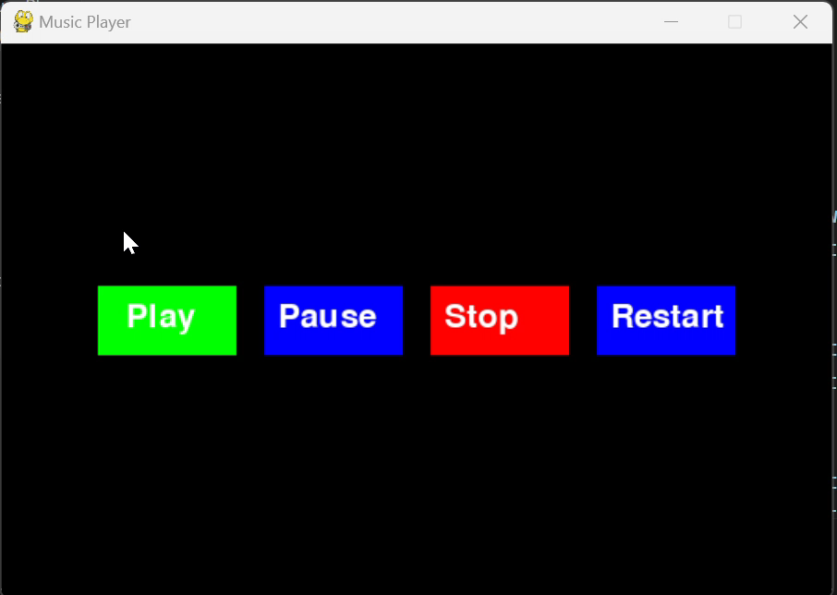
“Restart” Button
Add a Restart Button
Draw the Restart Button
Implement the Restart Button Functionality
restart_button = pygame.Rect(4 * WIDTH // 5 - button_width // 2, HEIGHT // 2 - button_height // 2, button_width, button_height)
elif restart_button.collidepoint(event.pos): # Check if Restart button is clicked
pygame.mixer.music.play(start=0) # Restart the music from the beginning

Slide 11
02-Volume Up and Down Buttons

Slide 12
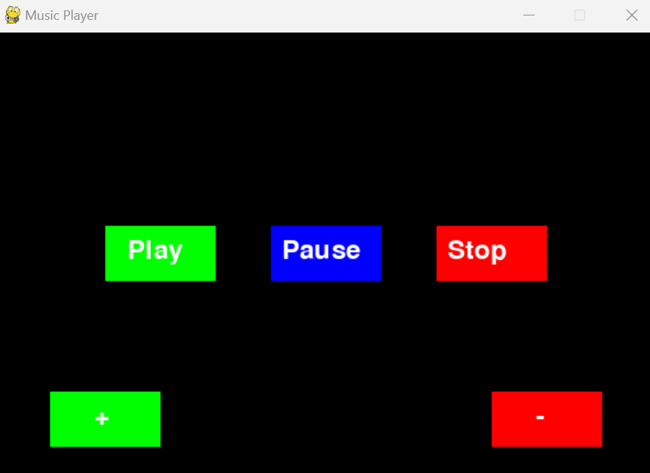
02-volumnButtons_music_playback

Slide 13
Task02-Adjust the Volume with Keyboard Keys

Slide 14
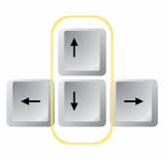
Task02-Adjust the Volume with Keyboard Keys
elif event.type == pygame.KEYDOWN:
if event.key == pygame.K_UP: # Increase volume
current_volume = increase_volume(current_volume)
elif event.key == pygame.K_DOWN: # Decrease volume
current_volume = decrease_volume(current_volume)

Slide 15
Task03: Create Volume Control Module

Slide 16
main.py
Goal: Create a volume_control.py module that defines functions to increase and decrease the music volume. Integrate this module with the main PyGame music player script (main.py) to control the volume using keyboard inputs.
import pygame
import sys
from volume_control import increase_volume, decrease_volume
# Initialize PyGame, set up the display, and load music as before
current_volume = pygame.mixer.music.get_volume()
# Main game loop
running = True
while running:
for event in pygame.event.get():
if event.type == pygame.QUIT:
running = False
elif event.type == pygame.KEYDOWN:
if event.key == pygame.K_UP: # Increase volume
current_volume = increase_volume(current_volume)
elif event.key == pygame.K_DOWN: # Decrease volume
current_volume = decrease_volume(current_volume)
# Fill the screen, draw UI elements, etc.
pygame.display.update()
pygame.quit()
sys.exit()
volume_control.py
import pygame
def increase_volume(current_volume, increment=0.1):
new_volume = min(current_volume + increment, 1.0)
pygame.mixer.music.set_volume(new_volume)
return new_volume
def decrease_volume(current_volume, decrement=0.1):
new_volume = max(current_volume - decrement, 0.0)
pygame.mixer.music.set_volume(new_volume)
return new_volume

Slide 17
03-audioProcesswithNumpy

Slide 18
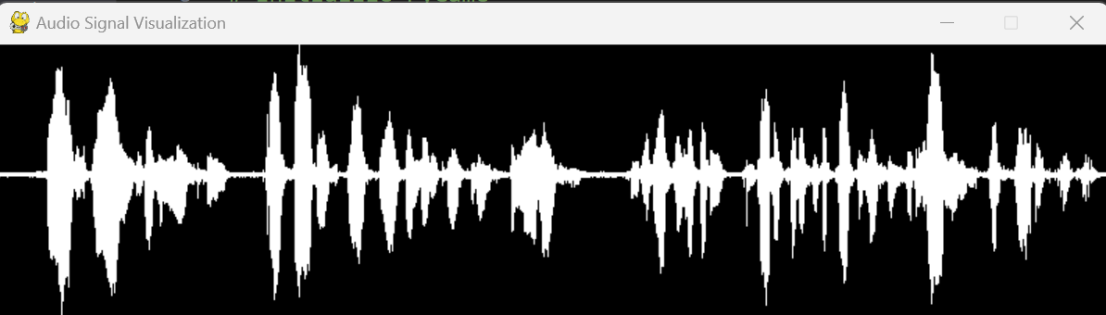
03-audioProcesswithNumpy
This normalization and scaling process allows the waveform to be visually represented in a way that maximally utilizes the available space
amplitude = np.interp(signal, (signal.min(), signal.max()), (0, HEIGHT))

Slide 19
Task04_Stop and Play Music with Keyboard Keys

Slide 20
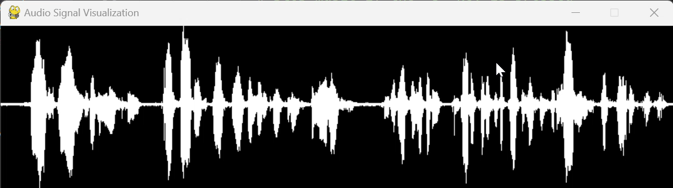
elif event.type == pygame.KEYDOWN:
# Stop music if the 's' key is pressed
if event.key == pygame.K_s:
pygame.mixer.music.stop()
# Play music if the 'p' key is pressed
if event.key == pygame.K_p:
pygame.mixer.music.play()

Slide 21
04-fileMenu_music_playback

Slide 22
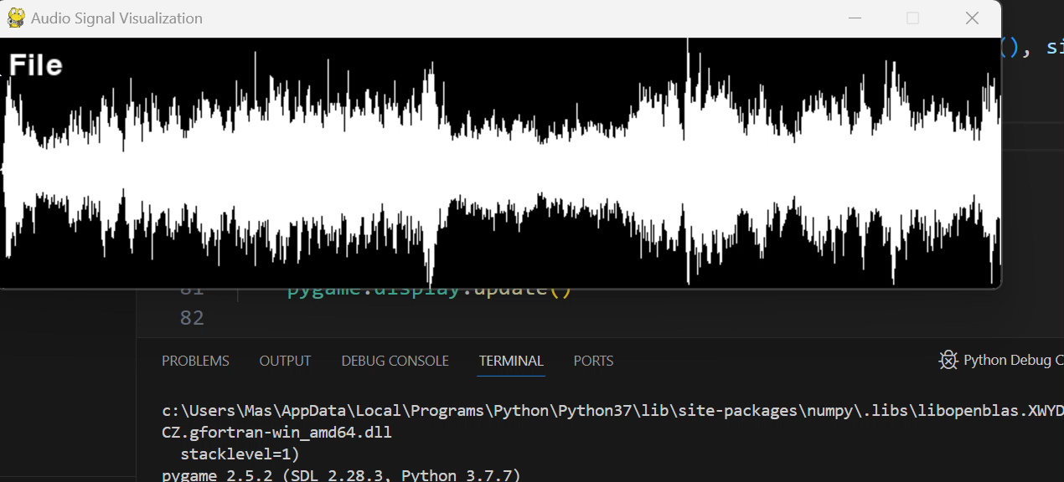
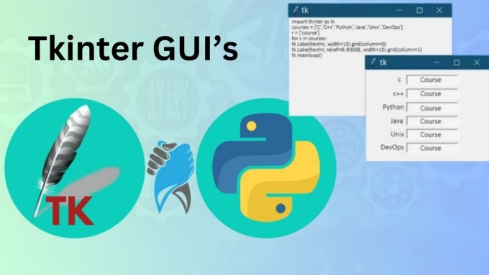
04-fileMenu_music_playback
import tkinter as tk

Slide 23
Task05_Create Music Player Module

Slide 24
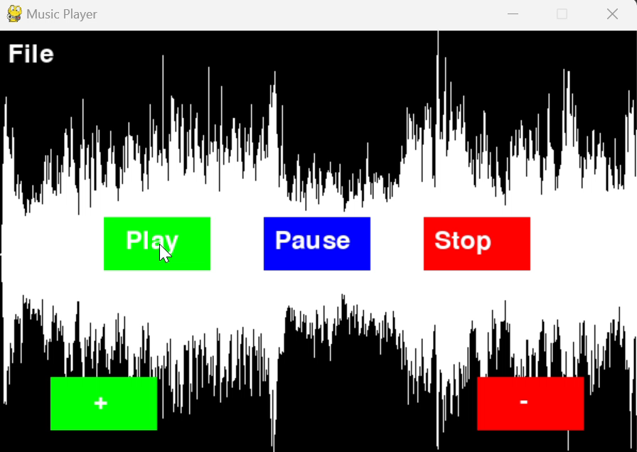
Task05_Create Music Player Module
volume_control.py
audio_visualization.py
filemenu.py
main.py

Slide 25
Additional Resources
Music Visualizer by Beat Detection

Slide 26
1. Libraries Installation
Pygame
Numpy
Sounddevice
soundfile
Matplotlib
Aubio
Pydub
librosa
pip install numpy scipy librosa pydub aubio matplotlib soundfile

Slide 27

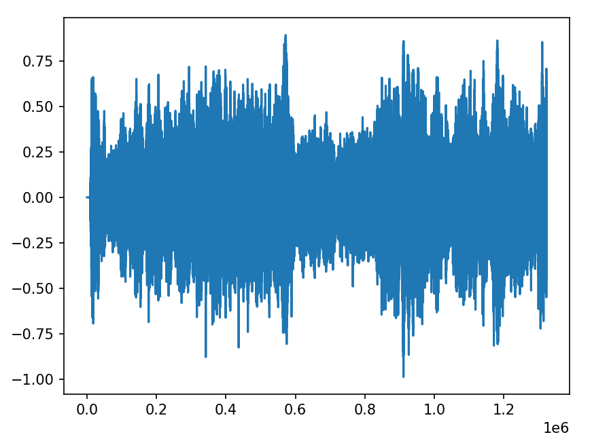
2. Audio visualization
Displaying waveform
import numpy as np import sounddevice as sd import matplotlib.pyplot as plt import soundfile as sf # Load the audio file filename = 'StarWars60.wav' #data, samplerate = sd.read(filename) data, samplerate = sf.read(filename, dtype='float32') # Get the average amplitude of the audio data average_amplitude = np.mean(np.abs(data)) print(average_amplitude) # Plot the audio data plt.plot(data) # Show the plot plt.show()

Slide 28
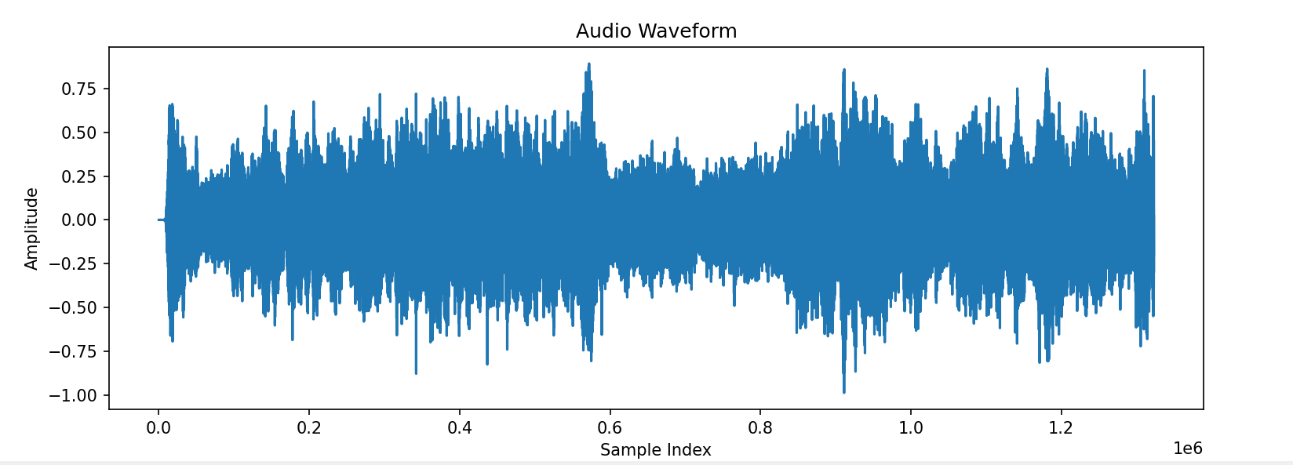
3. Pydub library
Convert audio data to numpy array using pydub
from pydub import AudioSegment import numpy as np import matplotlib.pyplot as plt def display_waveform(file_path): audio = AudioSegment.from_file(file_path) # Convert audio data to numpy array audio_data = np.array(audio.get_array_of_samples()) audio_data = audio_data / (2**15) # Plot the audio data plt.figure(figsize=(12, 4)) plt.plot(audio_data) plt.title('Audio Waveform') plt.xlabel('Sample Index') plt.ylabel('Amplitude') plt.show() # Replace "your_audio_file.mp3" with the path to your audio file file_path = "StarWars60.wav" display_waveform(file_path)

Slide 29
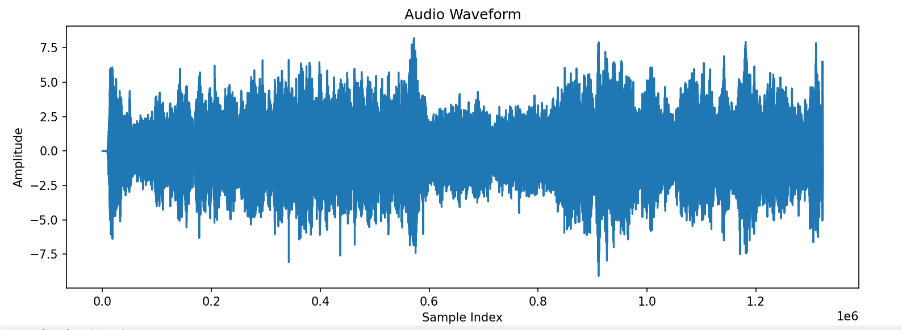
3. Pydub library
Convert audio data to numpy array using pydub
audio_data = audio_data / (np.mean(np.abs(audio_data)))
from pydub import AudioSegment import numpy as np import matplotlib.pyplot as plt def display_waveform(file_path): audio = AudioSegment.from_file(file_path) # Convert audio data to numpy array audio_data = np.array(audio.get_array_of_samples()) audio_data = audio_data / (2**15) # Plot the audio data plt.figure(figsize=(12, 4)) plt.plot(audio_data) plt.title('Audio Waveform') plt.xlabel('Sample Index') plt.ylabel('Amplitude') plt.show() # Replace "your_audio_file.mp3" with the path to your audio file file_path = "StarWars60.wav" display_waveform(file_path)

Slide 30
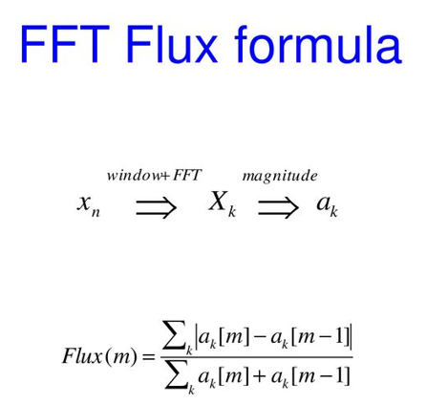
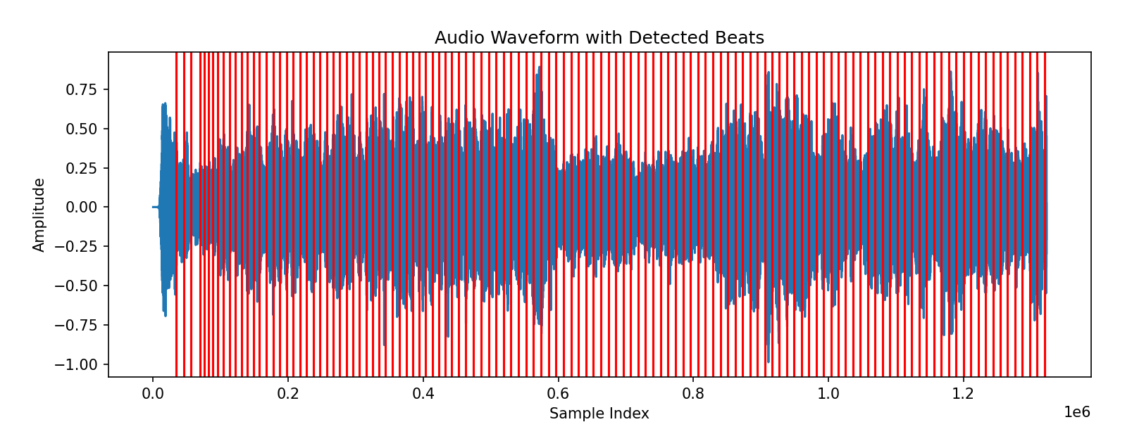
4. Aubio library for beat detection
import numpy as np import matplotlib.pyplot as plt from pydub import AudioSegment from aubio import source, tempo def display_waveform_with_beats(file_path): audio = AudioSegment.from_file(file_path) # Convert audio data to numpy array audio_data = np.array(audio.get_array_of_samples()) audio_data = audio_data / (2 ** 15) # Set up beat detection win_s = 512 hop_s = win_s // 2 samplerate = audio.frame_rate s = source(file_path, samplerate, hop_s) o = tempo("default", win_s, hop_s, samplerate) # Collect beat positions beats = [] while True: samples, read = s() is_beat = o(samples) if is_beat: beats.append(o.get_last_s()) if read < hop_s: break # Plot the audio data plt.figure(figsize=(12, 4)) plt.plot(audio_data) # Plot the detected beats for beat in beats: plt.axvline(x=beat * samplerate, color='r', linestyle='-') plt.title('Audio Waveform with Detected Beats') plt.xlabel('Sample Index') plt.ylabel('Amplitude') plt.show() # Replace "your_audio_file.mp3" with the path to your audio file file_path = "StarWars60.wav" display_waveform_with_beats(file_path)
Spectral Flux method, which measures the difference in energy between consecutive short-time spectral frames.

Slide 31
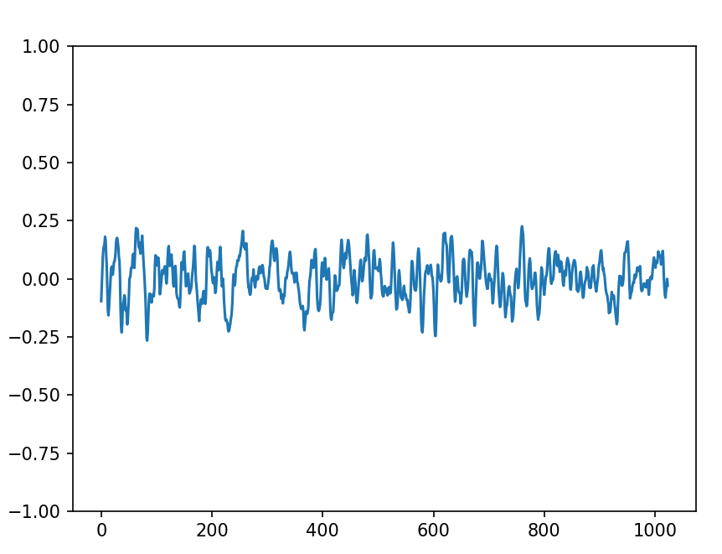
5. Audio Stream

